Slide 1

CurioBrowser
A Child-Safe Browser MVP
Protecting children. Respecting privacy. Empowering parents.
Presented by Team CodeOps: Sreyas Sharma, Mrutyunjaya Gouda, Supreet Kaur
CodeOps

Slide 2


The Digital Dilemma
1
2
Uncontrolled Web Access
Privacy Concerns
Our survey of 50 parents revealed that 78% struggle with effectively controlling their children's web access, leading to constant worry about exposure to inappropriate content.
Many existing "child-safe" solutions paradoxically collect extensive personal data, undermining the very privacy they claim to protect and creating mistrust among parents.
3
Poor User Experience
Children often find current browsers either too complex to navigate or overly restrictive, leading to frustration and a diminished learning experience.
CodeOps

Slide 3

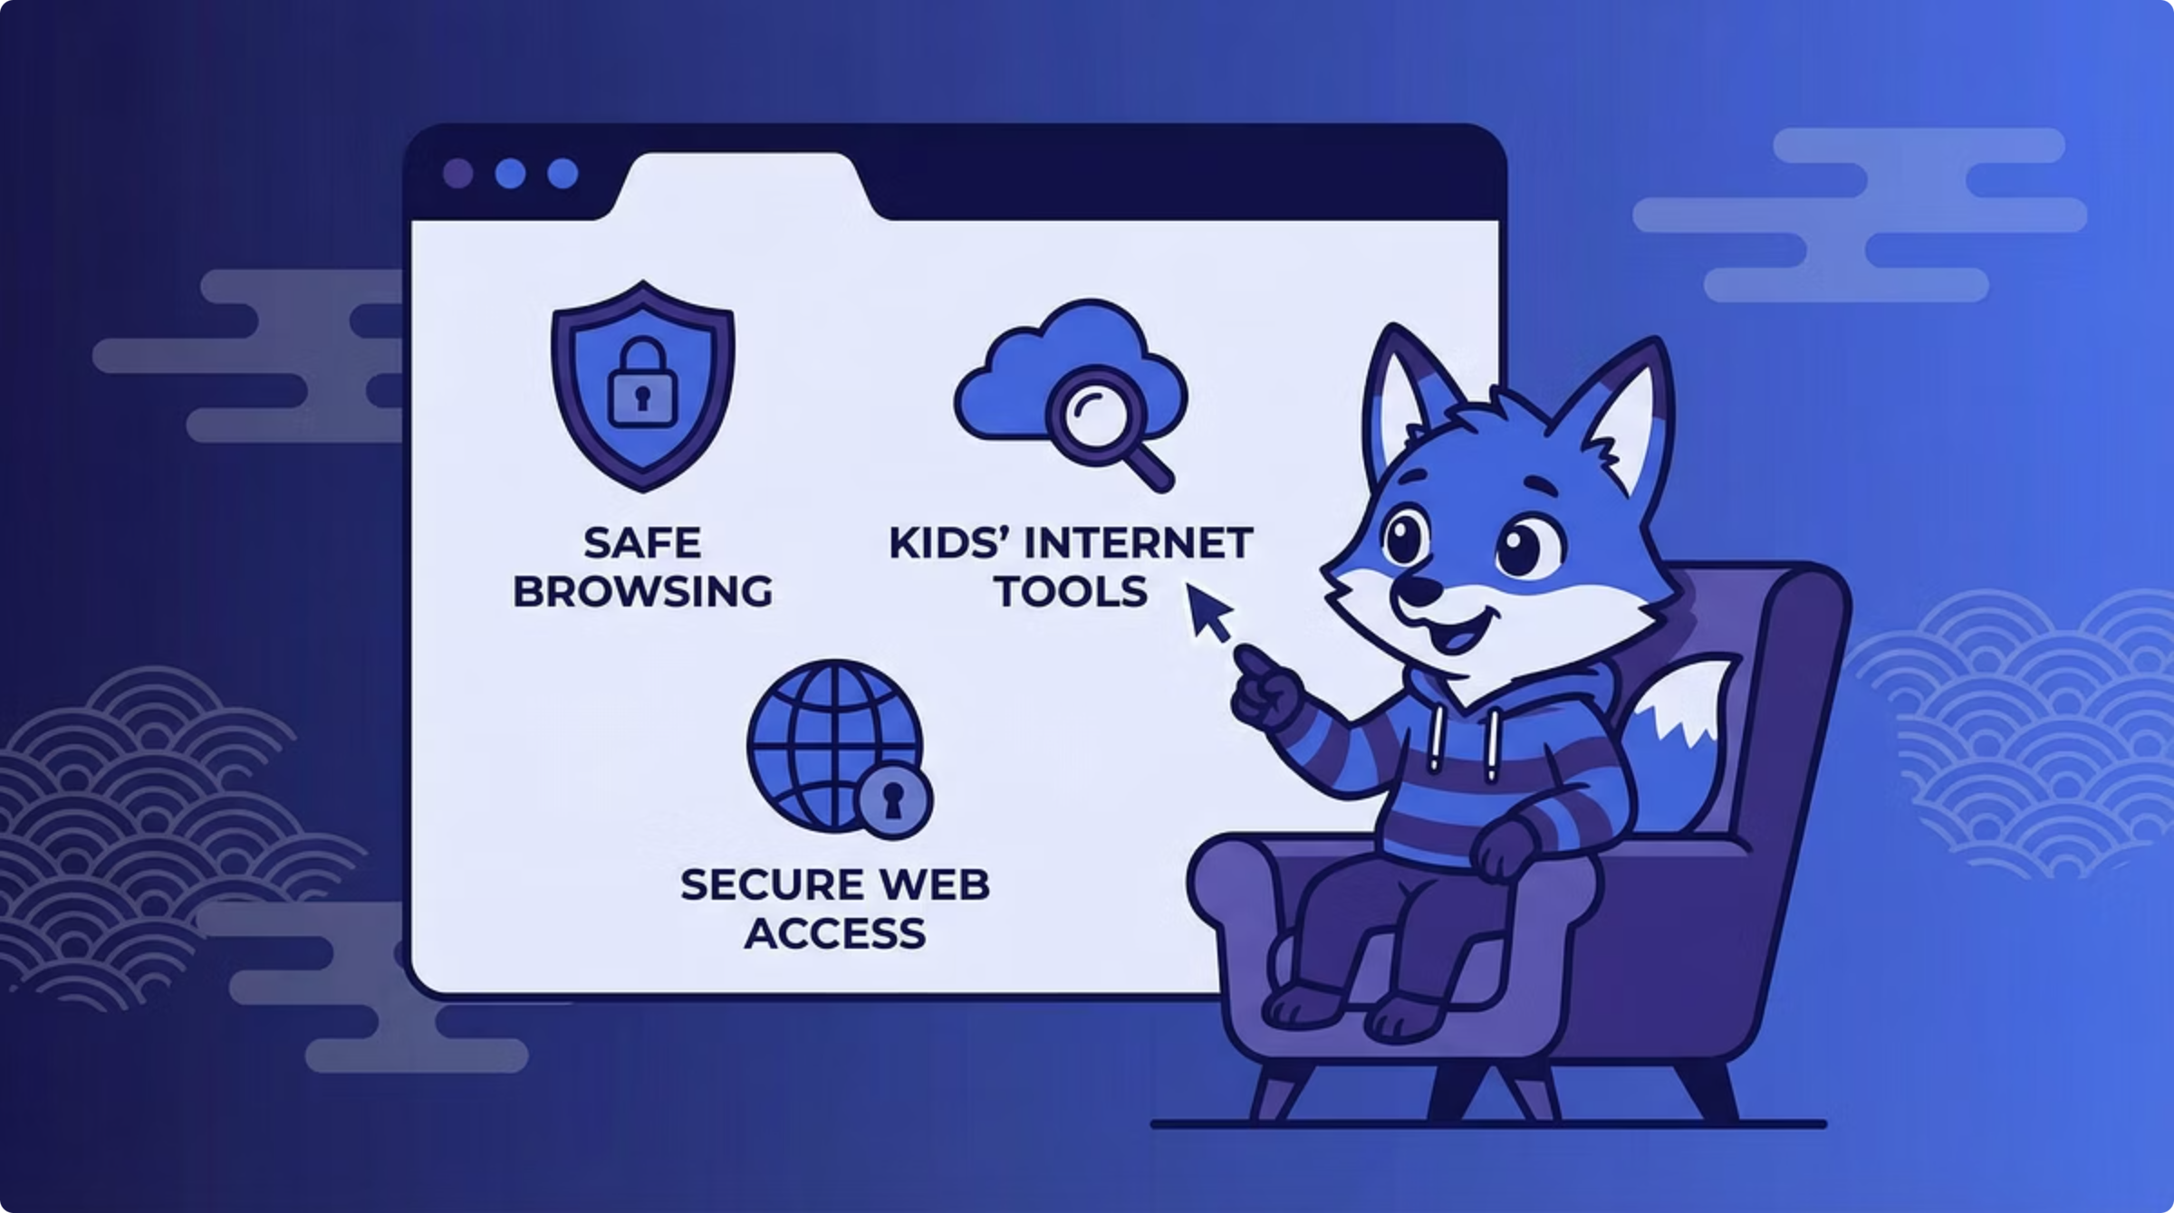
Our Iterative Solution
CurioBrowser is built from the ground up, integrating the best of technology with insights from real-world parenting challenges. Our development process is deeply rooted in user feedback.
Chromium-Based Foundation
Utilizes the robust and familiar Chromium engine, enhanced with custom safety extensions for a secure yet powerful browsing experience.
Azure AI Content Safety
Leverages advanced AI to provide intelligent, real-time content filtering, ensuring a consistently safe online environment for children.
Founder-Led Research
Our founder conducted 15+ in-depth interviews with parents to meticulously refine feature priorities and address genuine pain points.
Successful Pilot Beta
A pilot program involving 12 children and 15 parents resulted in an impressive 4.8/5 satisfaction rating, validating our approach and core features.
CodeOps

Slide 4




Core Safety Features
Intelligent Content Filtering
Absolute Privacy
CurioBrowser uses advanced algorithms to automatically detect and block inappropriate websites, ensuring children are protected from harmful adult content without constant parental intervention.
We commit to zero data collection. There is no tracking, no analytics, and no personal data stored, offering complete privacy and peace of mind for both children and parents.
Robust Malware Protection
Real-Time Phishing Defense
Our sandboxing technology isolates potential threats, preventing malware from infecting the device and creating a secure browsing environment even when encountering unknown sites.
CurioBrowser actively detects and blocks phishing attempts in real-time, safeguarding children from fraudulent websites designed to steal personal information.
CodeOps

Slide 5



User Experience & Learning
Simple & Intuitive UI
Child-Friendly Chatbot
Designed with children in mind, our interface is clean, uncluttered, and easy to navigate, reducing frustration and making online exploration a joy for all ages.
An custom AI assistant powered by Azure OpenAI provides homework help, answers questions, and supports learning in a safe, interactive way.
CodeOps

Slide 6





Empowering Parental Control
GRANULAR WEBSITE CONTROL
Parents have full authority to approve or deny specific websites, customizing their child's online landscape with precision and flexibility.
NON-INTRUSIVE ACTIVITY MONITORING
Gain peace of mind with real-time insights into browsing activity, designed to be informative without being overly intrusive or privacy-violating.
TIME MANAGEMENT & LIMITS
Set healthy boundaries with customizable session limits and time restrictions, helping children develop balanced digital habits.
EDUCATION-FOCUSED ENCOURAGEMENT
CurioBrowser actively encourages visits to educational websites and resources, fostering a love for learning in a safe digital space.
CodeOps

Slide 7


Powered by Microsoft Technologies
Core Platform
Chromium (Edge engine)
C++
Windows/macOS/Linux compatibility
Backend & AI
Azure Static Web Apps for dynamic content
Azure Functions for serverless logic
Azure OpenAI for advanced chatbot capabilities
Safety & Security
Azure AI Content Safety for filtering
Azure Key Vault for secure secrets management
Sandbox isolation for threat containment
Data & Monitoring
Azure Cosmos DB for scalable parent analytics
Application Insights for robust performance monitoring
CodeOps

Slide 8





MVP Status: Fully Functional
Core Browser Engine
The Chromium-based engine is fully operational, providing a stable and fast browsing foundation.
Content & Phishing Protection
Achieving over 95% accuracy in content filtering and real-time phishing detection, ensuring top-tier safety.
Malware Defense
Integrated sandbox environment and robust malware protection are fully functional, securing the browsing experience.
AI Chatbot
The Azure OpenAI integrated chatbot has been successfully tested with 12 children, demonstrating its effectiveness as a learning aid.
Parent Dashboard
Our beta parent dashboard is ready for demonstration, offering intuitive analytics and control features.
CodeOps

Slide 9





Let's Protect Children Online
Join us in building a safer, more private digital world for our children.
We invite you to a live demonstration of CurioBrowser's features, including a walkthrough of the child-safe browsing experience and the intuitive parent dashboard.
CodeOps

